Slide 1
Python week 1
Canberra Chinese School Sem1

Slide 2
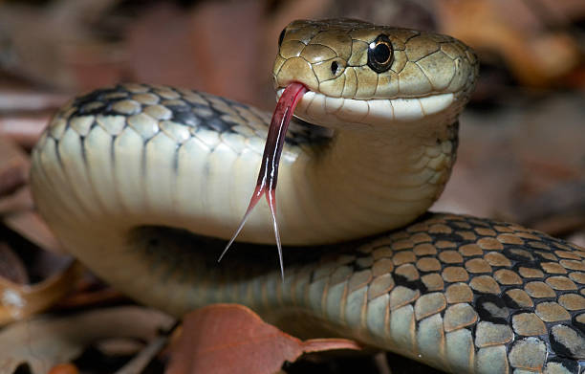
Python
For i in list:
do something
Here, list needs to be something that we have defined already.
But “i” can be named whatever you like.

Slide 3



Slide 4
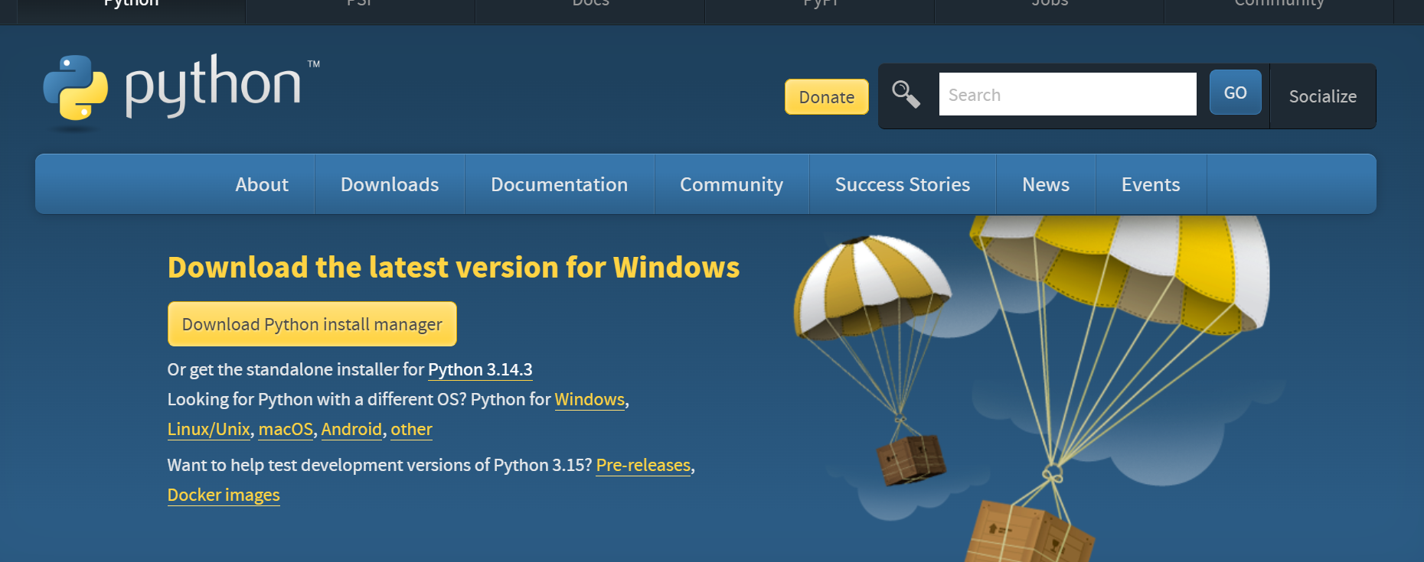
Download Python

Slide 5
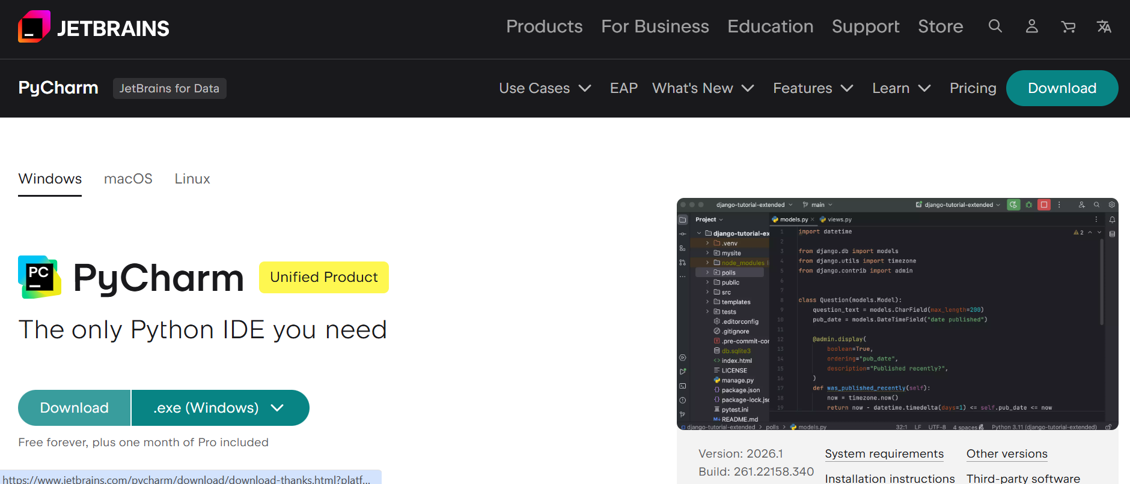
Download IDE (integrated development environment)

Slide 6
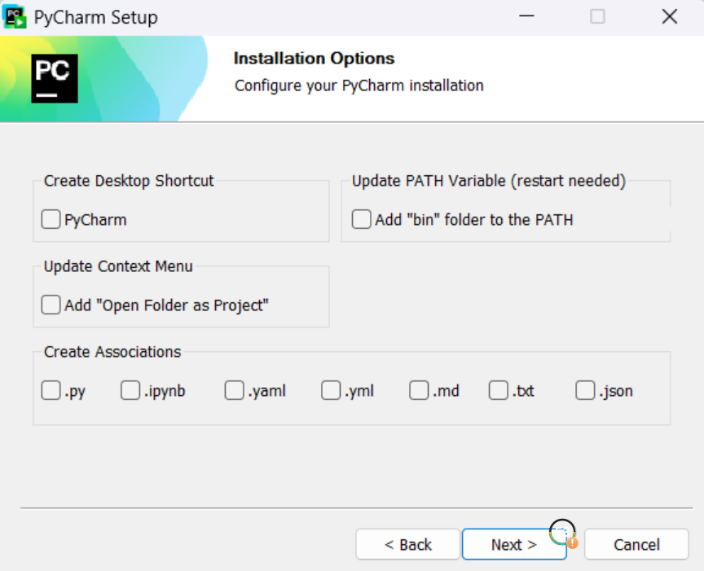
Download IDE (integrated development environment)

Slide 7
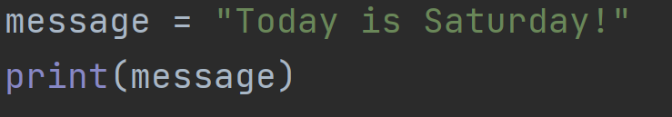
Example Program

Slide 8

Strings

Slide 9
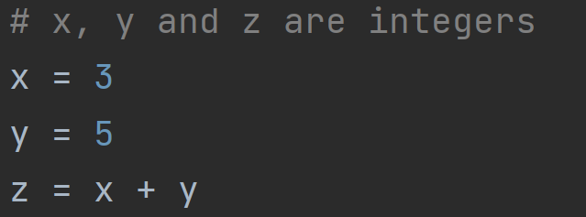
Integers

Slide 10
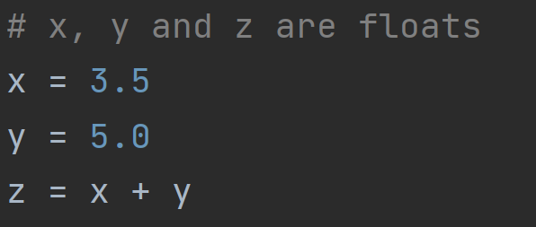
Float

Slide 11
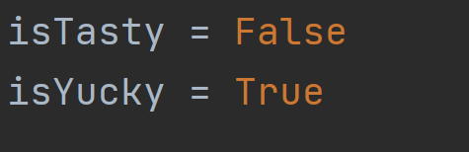
Booleans

Slide 12
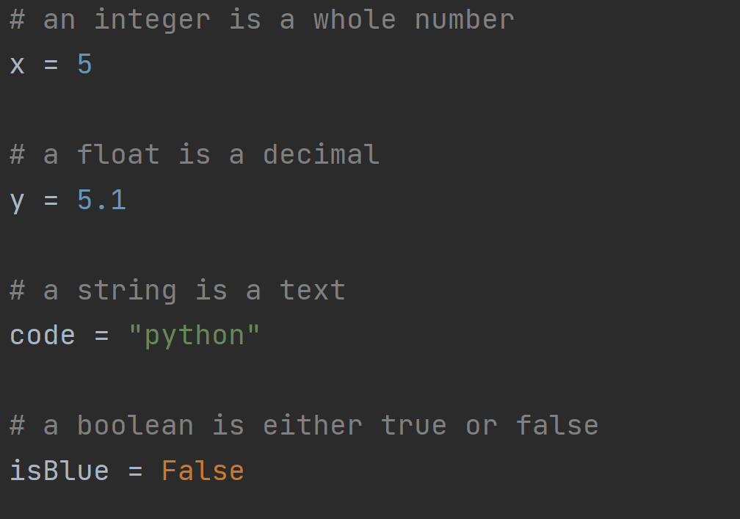
Summary

Slide 13
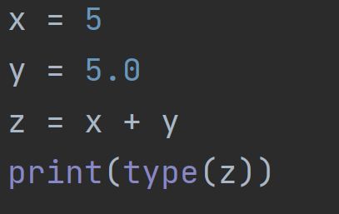
Quiz 1
What is the type of z?
A. Integer
B. Number
C. Float
D. String

